Slide 1
Host a hackathon In your city!
By @arielsanchezmor
V1.0

Slide 2
A favor
Take a pic during this session!
Tweet it out with #vbrownbag and #vmworld
I really like interacting with people in Twitter and the #vCommunity

Slide 3
A bit about me
Costa Rican in Orlando
Sr TAM @VMware, CTO Ambassador
Advocate of the vCommunity (vBrownBag crew, vExpert, VMUG, VTUG, vBeers, vBrisket…)
I started using Twitter in 2013 for VMW
I want to help other people do local hackathons

Slide 4
Agenda
Why Little Hackathons work so well
Get involved and create them in your community
Lessons learned to make them successful

Slide 5
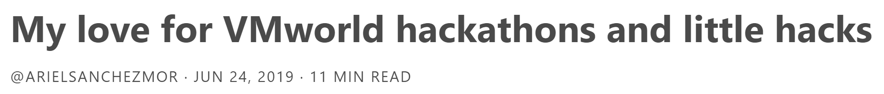
Hackathons!
http://blogs.arielsanchezmora.com
##vmworldhackathon

Slide 6
Why Little Hackathons work so well
Smaller meetings closer to you -dont need a sponsor -‎power, just a whiteboard and some chairs (typical office)
#PGHLittleHack inspired by the VMworld Hackathon

Slide 7
vCommunity
The very welcoming people working with virtualization technology who you frequently meet at VMware user groups and conferences.
Typically are on twitter and are very willing to share information

Slide 8
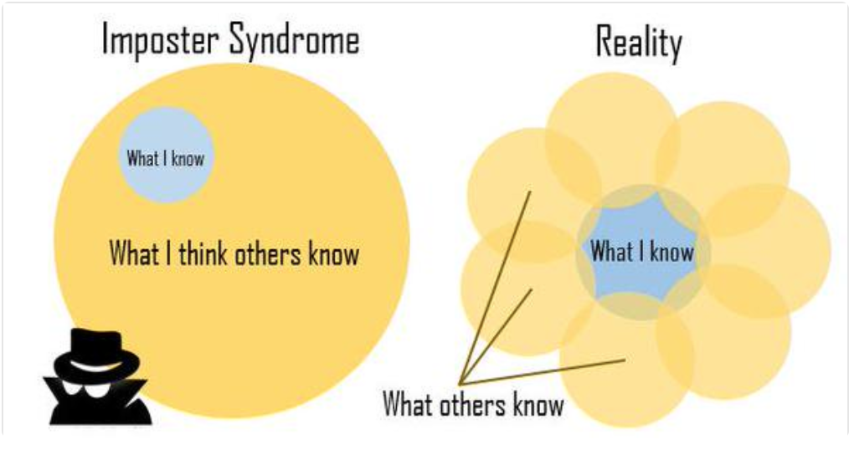
How you can get involved
Getting past "I don't know anything"

Slide 9
‎Failure is temporary!
Contributing is crucial
You will learn so much more by interacting and teaching others
Presenting itself is something that takes practice to do well
Just try to get better each time. That’s all!

Slide 10
Typical stages of participation
-lurk
-‎interact
-‎contribute
-‎mentor? Or how I call it “PUSH OTHERS”

Slide 11
Lessons learned to make them successful
Do it for the right reasons
Everyone brings something to the table
Attitudes that build community:
1) The most required attitude: Positivism!

Slide 12
Attitudes that build
2) Frankness / Openness -‎If you think I'm wrong, that's ok! Show me, I want to get better -‎I would rather you tell me now than wait
3) Respect -‎ Always be nice and treat others like you would like to be treated -Really caring about people. Jobs can change, but friends can last forever

Slide 13
Communication
Blog post makes the date official
Hashtag! #PGHLittleHack #BCLittleHack
Tweet and post to your VMUG chapter
Create a Slack group in VMware Code
The VMware Code Slack is free and automation/programming related, which ties into the theme

Slide 14
Share your scripts
Share openly if you can -everybody steals shares -powerCLI or esxcli or Ansible or… -API/SDK interactions -‎VMware Code Sample Exchange
If you can’t share in Github/etc, that’s ok, you can still help others by attending!
Blog posts make it easy to present and share

Slide 15
BENEFITS
All of this will bring you -Friends!!! -‎Contacts for when you need help -‎”Resume” to apply for vExpert and others
-‎New knowledge - keeping up to date! -‎Knowing who knows about X -Access to career mentors

